Slide 1
Student Course Registration System
Kyle Burt
CST 499 Capstone For Computer Software Technology
Professor Butler
6/29/26

Slide 2
Software Requirements Specification
Defined the purpose and scope of the Student Course Registration System.
Identified students and administrators as primary users.
Included functional requirements such as user registration, login, course enrollment, viewing schedules, and dropping courses.
Included nonfunctional requirements including security, reliability, performance, and usability.
Served as the blueprint for the entire development process.

Slide 3
UML Design Model
Created UML diagrams before development.
Designed a Use Case Diagram to show user interactions.
Created an Activity Diagram to illustrate system workflows.
Developed a Sequence Diagram to show communication between system components.
Built a Class Diagram to represent system objects and relationships.

Slide 4
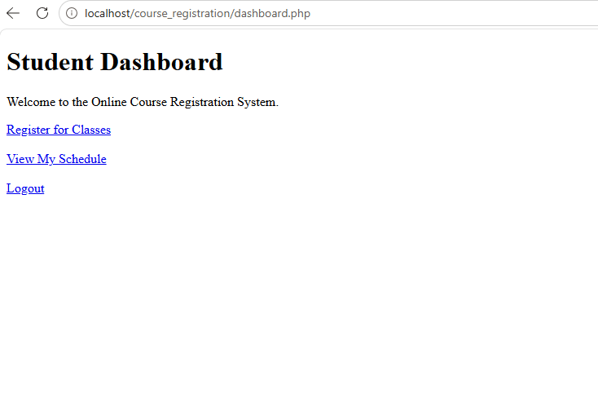
Landing Page
Serves as the main entry point into the application.
Provides navigation to register or log in.
Designed with a clean and user-friendly interface.
Allows users to quickly access the registration system.

Slide 5
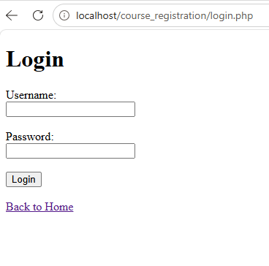
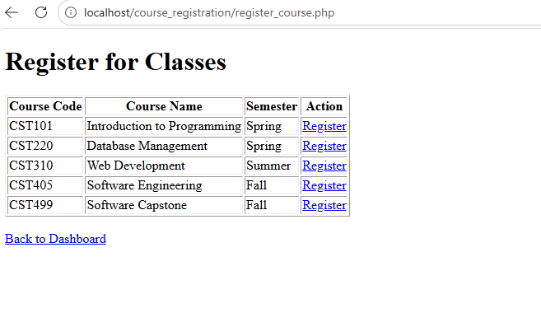
Login and Registration Pages
Users create an account through the registration page.
Login page authenticates users before granting access.
PHP validates user input.
Credentials are securely verified against the MySQL database.
Error messages are displayed when invalid information is entered.

Slide 6
Enrollment System
Dashboard provides access to all system functions.
Students can register for available courses.
Students can view their schedules.
Students can drop registered courses.
Registration data is automatically updated in the database.

Slide 7
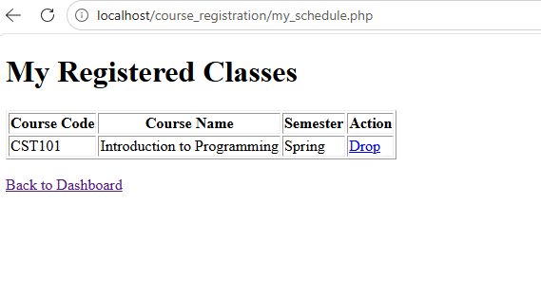
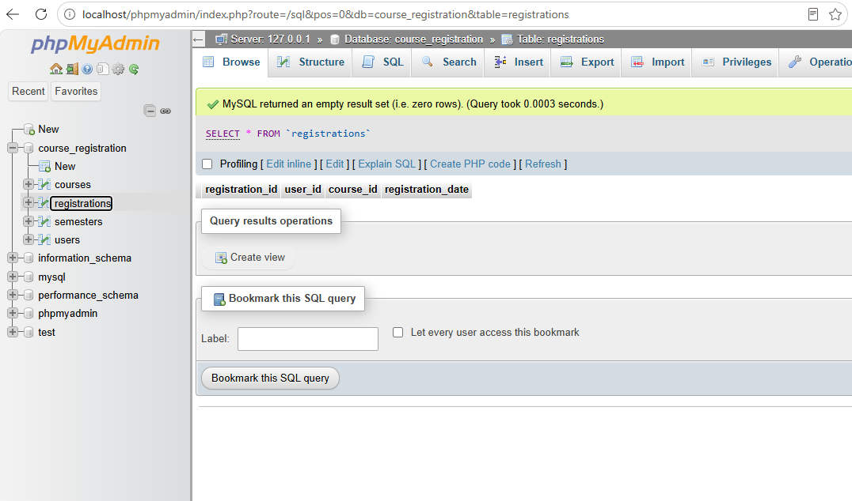
Enrollment System Photos

Slide 8
MySQL Database
Built using MySQL.
Stores users, courses, and registration information.
Uses relational tables with primary and foreign keys.
Maintains accurate student registration records.
Supports dynamic updates from the PHP application.

Slide 9
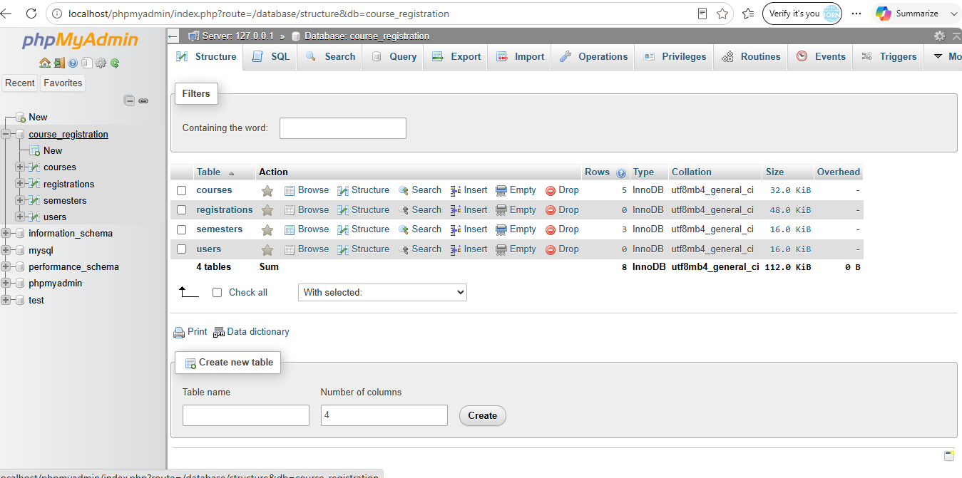

Slide 10
PHP Code
Developed using PHP for server-side programming.
Connected the application to the MySQL database.
Processed user forms and requests.
Managed user sessions.
Generated dynamic web pages based on database information.

Slide 11
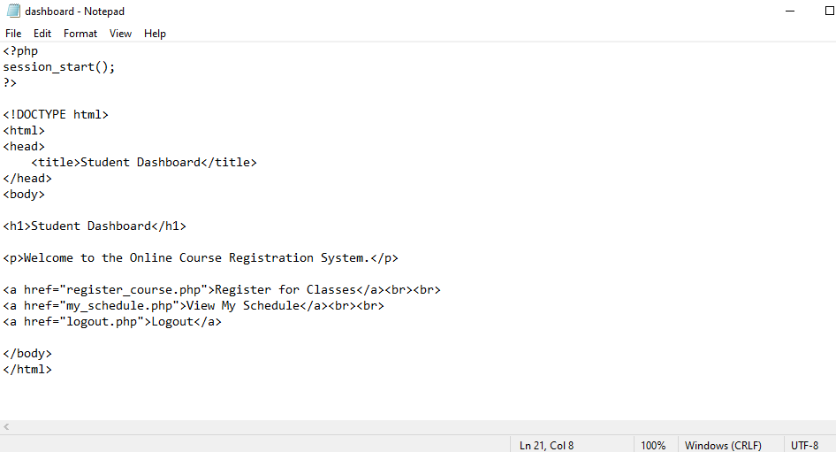
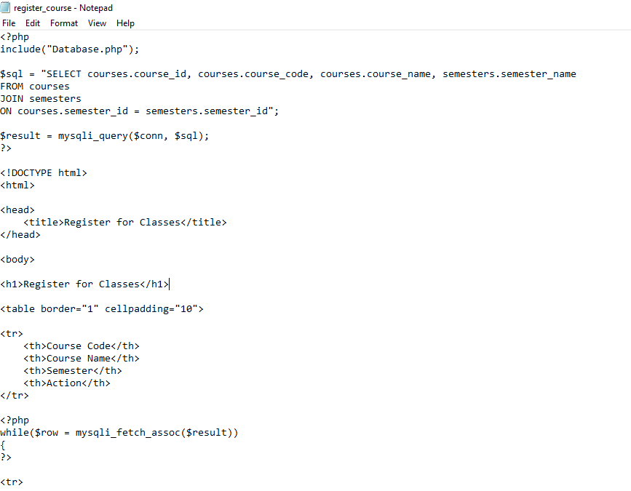

Slide 12
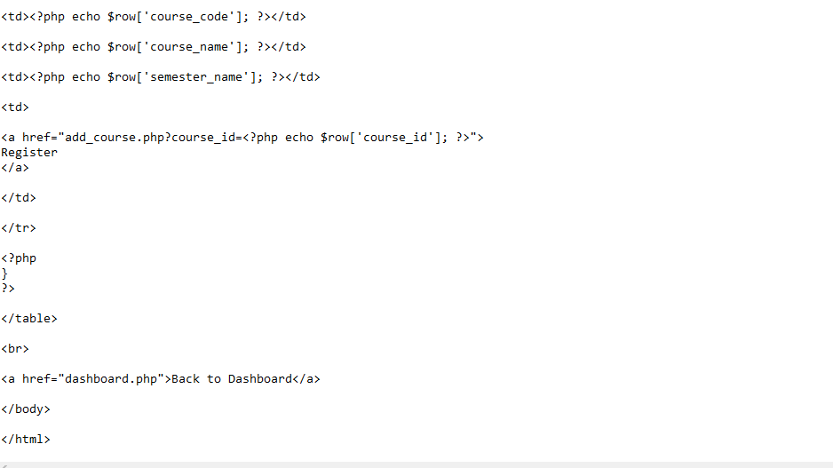
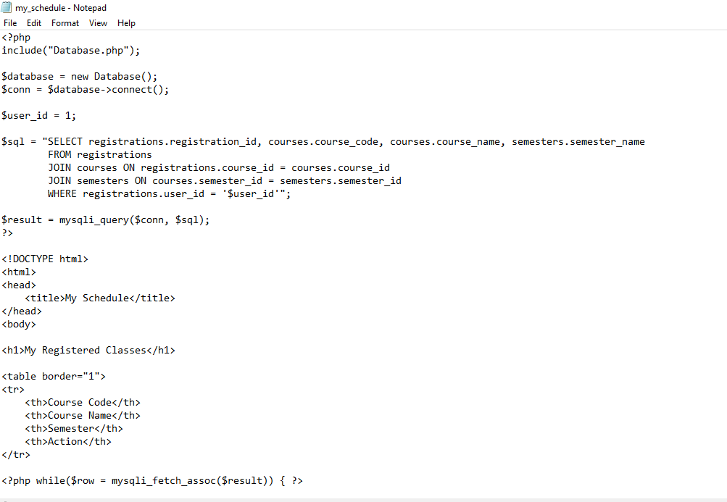

Slide 13
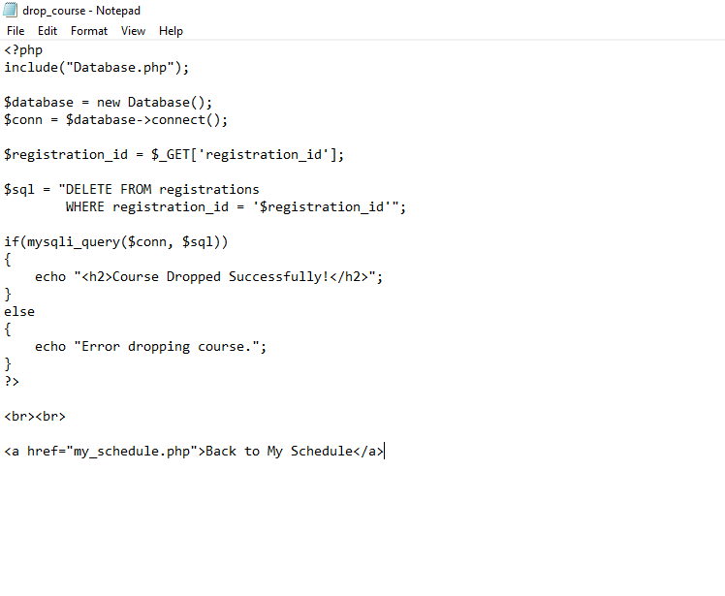

Slide 14
Challenges and Lessons Learned
Learned to connect PHP with MySQL.
Debugged programming errors.
Configured XAMPP for local development.
Tested each feature to ensure functionality.
Improved software development and problem-solving skills.

Slide 15
Project Summary
Successfully completed all phases of the Software Development Life Cycle.
Created software requirements and UML designs.
Developed a functional web application using PHP and MySQL.
Implemented secure login and course registration features.
Demonstrated practical software engineering skills.

Slide 16
References
Pressman, R. S., & Maxim, B. R. (2020). Software engineering: A practitioner's approach (9th ed.). McGraw-Hill.
Sommerville, I. (2020). Software engineering (10th ed.). Pearson.
Oracle. (2026). MySQL 8.4 Reference Manual. https://dev.mysql.com/doc/
PHP Group. (2026). PHP Manual. https://www.php.net/docs.php

